Slide 1
Executives Will Want to use MBSE
The value of MBSE to a non-engineer
RR024/01: August 2022

Slide 2
Contents
What is MBSE (Model Based Systems Engineering)?
Executives will want to use MBSE
WIFM – what’s in it for me?
Understand the CEO’s point of view
Understand the CFO’s point of view
What’s the story of MBSE?
What is the problem we want to solve?
Working with pieces of information
Connect the dots together to tell a story
Connect the dots using a defined set of rules
Define your project’s MBSE process
Summary – benefits of MBSE
Define the uses/missions for the proposed system
Describe operational scenarios for each use case
Create system context diagram to identify external systems
Create system context diagram to identify external interfaces
Define the system hierarchical structure (level by level)
View a block’s properties
View a block’s component parts and their interactions
Describe the functional behaviour of a block or process
Describe the events/messages exchanged by different blocks
Describe a block’s states and transitions
Identify a performance constraint for a system block
Present requirements flow-down traceability

Slide 3
What is MBSE (Model Based Systems Engineering) 1
Model Based Systems Engineering (MBSE) is defined by the International Council on Systems Engineering (INCOSE) as follows:
“The formalized application of modelling to support system requirements, design, analysis, verification and validation activities beginning in the conceptual design phase and continuing throughout development and later lifecycle phases. MBSE enhances the ability to capture, analyse, share, and manage the information associated with the specification of a product.” Taken from the INCOSE System Engineering Handbook.
Your CEO, CFO, COO, VP of anything but Engineering DOESN’T CARE about MBSE!

Slide 4
Executives Will Want to use MBSE 2
To a Systems Engineer the value of MBSE is as follows:
Enhanced knowledge capture and reuse of the information
Improved communications among project members and stakeholders
Enhanced ability to compare architecture specifications
Dwight Eisenhower said “Leadership is the art of getting someone else to do something you want done because he wants to do it.”
How do you get a non-engineering executive to want MBSE and provide the budget for the time, training and tools needed to do it successfully?

Slide 5
WIFM – What’s in it for Me? 3
CEO, GM, Program Manager
Brief visual communication verses long documents
Reduced cost
Remember – How to will provide needed support information – but should not be your lead argument
CFO, other financial lead
Reduced cost
More accurate budgeting of time and money

Slide 6
Understand the CEO’s Point of View 4
Know where they came from
Engineer that came through the ranks to the top exec
Business guy that closed contracts or program manager to keep things running
Founder, placed after a merger/buyout??
What are big picture company goals
What do the shareholders/stakeholders expect?
How is the executive or manager evaluated/compensated
How does MBSE support these

Slide 7
Understand the CFO’s Point of View 5
Cost savings – but in context with your business model
Does your business bill by the hour on a contract?
Fixed firm price contracts
Sell finished products verses services
Accuracy of schedule and costs
Increasing predictability

Slide 8
So, What’s the Story MBSE Tells? 6
How does more visualisation of information help the product specification process?
Do not tell executives how we create the visual models
Discuss the “value-add” to the organisation
For example, a graphical diagram shows in one picture what may take pages and pages of text to convey – things get missed by the 15th page, the graphical picture makes it obvious. The graphical picture with a textual description for each symbol.

Slide 9
What is the Problem we Want to Solve? 7
Problem:
When project information is spread across multiple documents, and captured as free form text, the lack of consistent traceability can result in labour intense activities when examining project data.

Slide 10
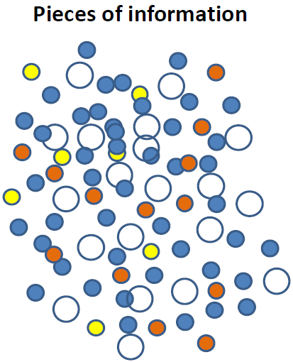
Managing the Pieces 8
Systems Engineers work with pieces of information so maybe we should manage the pieces.
Engineers utilise a large amount of different “pieces of information” to design, analyse, verify and validate a new system or modifications to an existing system.
What do we do with the dots?

Slide 11
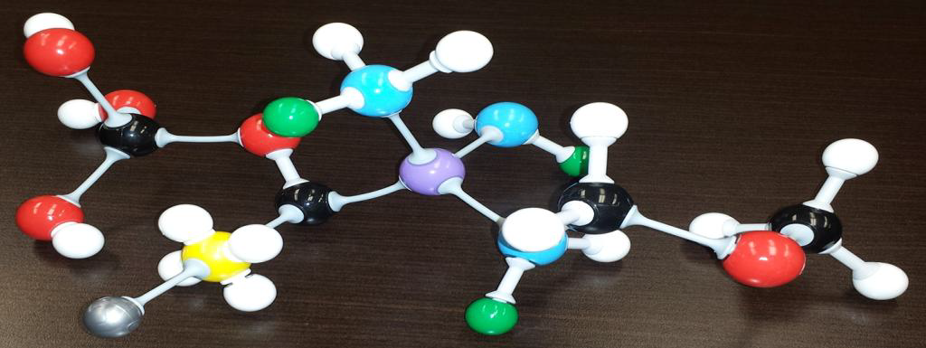
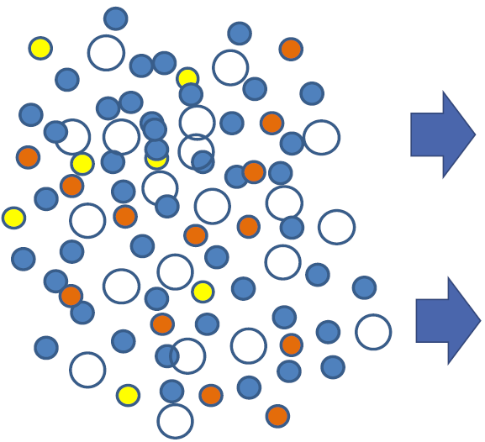
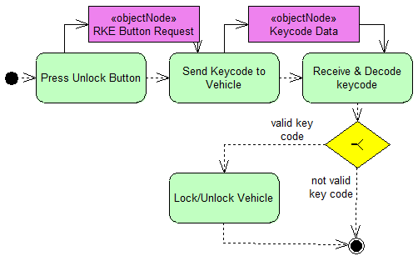
Connect the Dots Together to Tell a Story 9
A piece of information by itself has limited value, but when associated with one or more other pieces of information via relationships (i.e. cross reference links), the information has more value to the project.

Slide 12
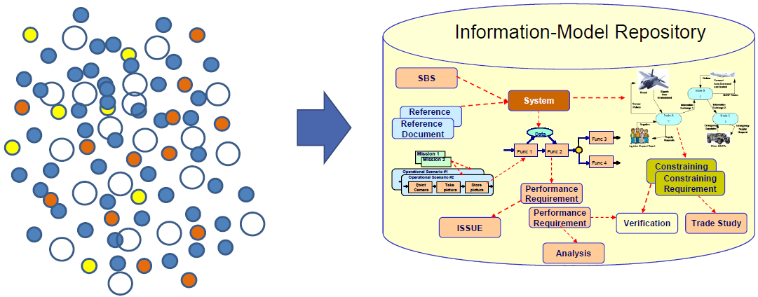
Connect the Dots Using a Defined Set of Rules 10
The result of connecting the dots using a defined set of rules is a structured information model.
The information model consists of elements, relationships that establish traceability between elements, and diagrams (conceptual models). This information is stored in a repository (i.e. database) that is accessible by computer-based tools.
This type of structured approach is known as a Model-Based Systems Engineering (MBSE) process. The process defines the rules to use to connect the dots.

Slide 13
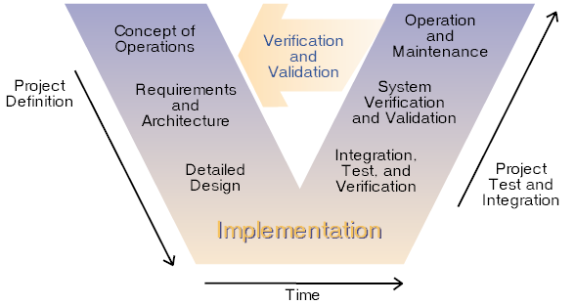
Define Your Project’s MBSE Process 11
Define the project’s Systems Engineering process and methods and then identify the information model, element types and diagram types to be used on the project.
Technical Management Processes
Decision analysis
Technical planning
Technical assessment
Requirements management
Architecture management
Risk management
Configuration management
Technical data management
Interface management
Traceability management
Technical Processes
Requirements development
Logical architecture
Physical architecture
Design solution
Implementation
Integration
Verification
Validation
Transition

Slide 14
Summary – Benefits of MBSE 12
Project Activities | MBSE Methods | Document-Centric Methods | Best Method
Reviews (SDR, PDR, CDR) | Interrogate models following established traceability links | Read and interpret text and find related information manually. Labour intensive and time consuming. | MBSE built-in traceability
Communication | Stories described using established traceability links and known modelling rules mean less reader interpretation. | Read and interpret text to understand a specific story but because the information is free form text the understood story is based on reader perspective and is very subjective. | MBSE built-in traceability
Verification | Follow the built in traceability links to access all relevant information associated with a verification audio. | Human must read the different documents to perform verification audio. Because there is no built in road map the next reviewer may miss something. | MBSE built-in traceability
Validation | Follow the traceability links through different views (e.g. customer’s context, developers context, requirements view, etc.) | Walk through document reviews based on reading the entire document and mentally linking relevant information together on the fly. Each reviewer must repeat the process. | MBSE built-in traceability
Summary | Traceability of requirements to design to verification is built into the information model. | Assuring accuracy of traceability of requirements to design to verification is labour intensive and very time consuming. | MBSE built-in traceability

Slide 15
If the executive gets excited and says, “show me examples of the kinds of models the team will build”, use simple example diagrams as shown on the following slides.

Slide 16
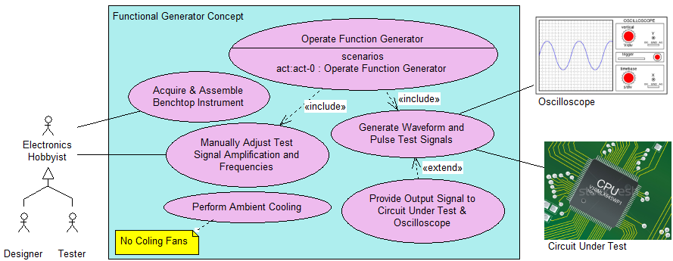
Define the Uses/Missions for the Proposed System 13
A Use Case Diagram displays a set of use cases (the mission/goals for the subject system) as well as the actors/stakeholders that invoke and participate in those use cases.
To understand a use case we tell stories. These stories cover how to successfully achieve the goal/mission, and how to handle any faults/problems that may occur.

Slide 17
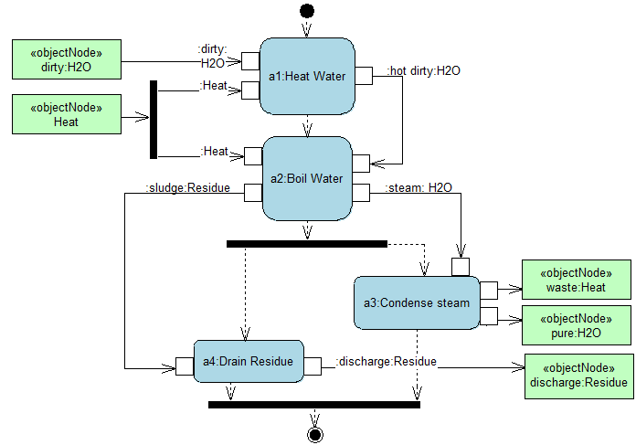
Describe Operational Scenarios for each Use Case 14
This Activity Diagram (act) is used to specify the operational activities needed to accomplish the linked use case.

Slide 18
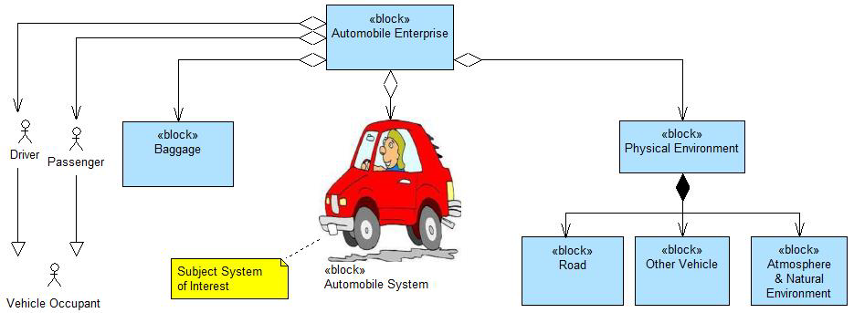
Create System Context Diagram to Identify External Systems 15
This bdd System Context Diagram is defining all relevant external systems the system under development must interact with.

Slide 19
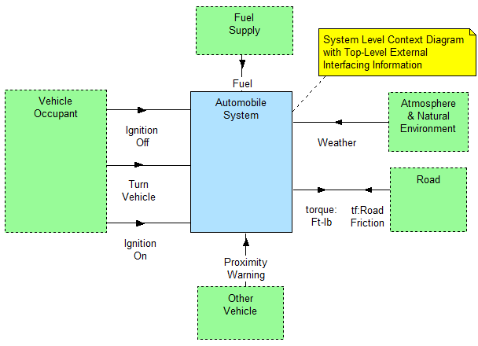
Create System Context Diagram to Identify External Interfaces 16
This Internal Block Diagram (ibd) shows the internal structure of a high-level block and how the internal entities are interconnected, and what flows across the connections (i.e. external interfaces).

Slide 20
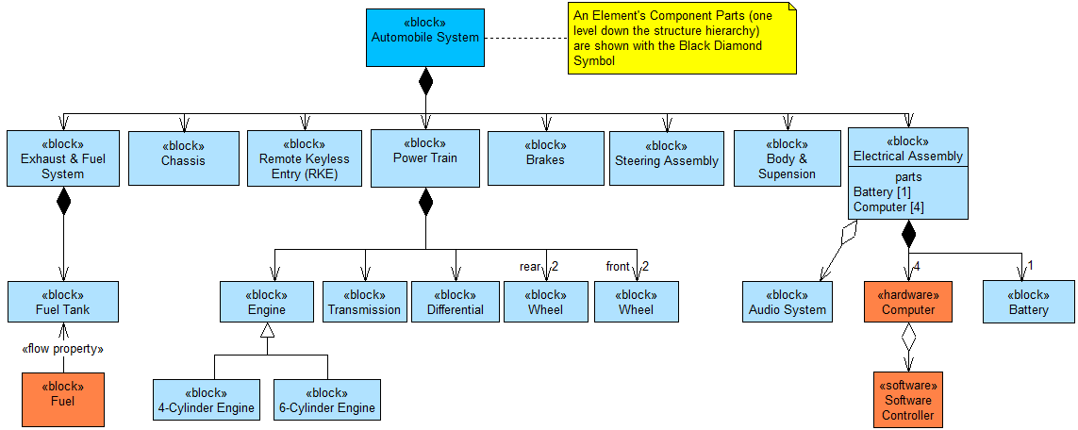
Define the System Hierarchical Structure (Level by Level) 17
This bdd shows the structure of the proposed system (i.e. component parts). A block represents a type of “thing” (e.g. system, subsystem, light, report, organisation, human, etc).

Slide 21
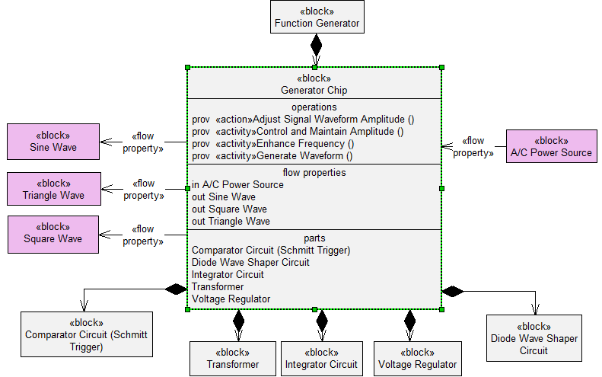
View a Block’s Properties 18
This bdd shows the optional compartments of a block that can be displayed.

Slide 22
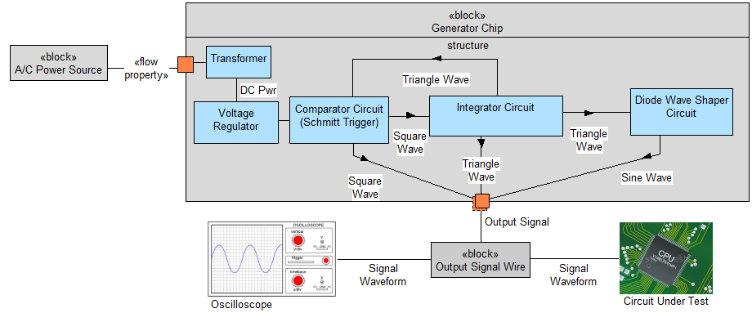
View a Block’s Component Parts and their Interactions 19

Slide 23
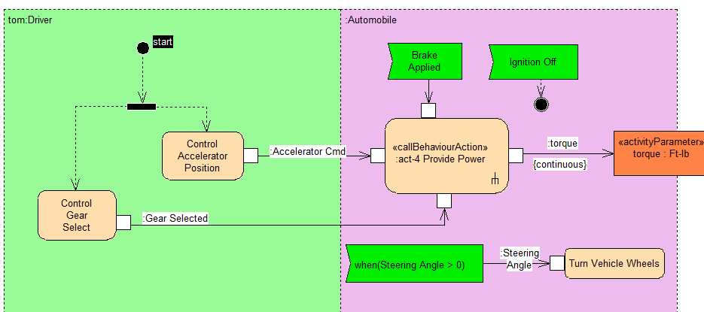
Describe the Functional Behaviour of a Block or Process 20
The behaviour (represented by an Activity Diagram) specifies the transformation of inputs to outputs through a controlled sequence of time ordered actions/functions.

Slide 24
Describe the Functional Behaviour of a Block or Process: 2

Slide 25
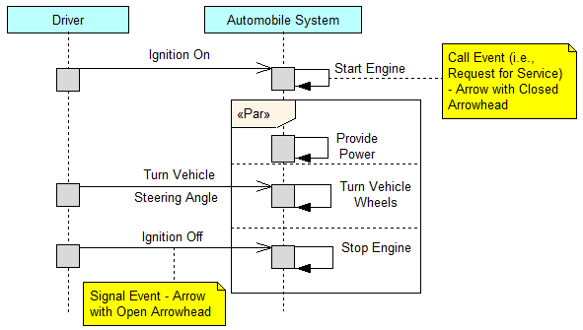
Describe the Events/Messages Exchanged by Different Blocks 21
The Sequence Diagram (sd) is used to represent the interaction between structural elements (parts) of a block, as a sequence of message exchanges.

Slide 26
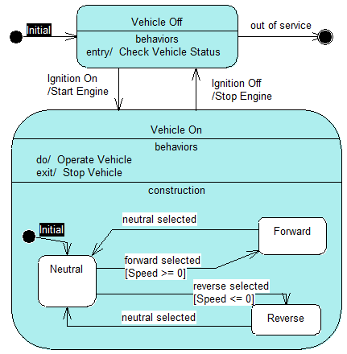
Describe a Block’s States and Transitions 22
A State Machine Diagram is used in SysML to describe the state-dependent behaviour of a block throughout its lifecycle in terms of its states and the transitions between them. This diagram type is an alternative method to the activity diagram to describe behaviour.

Slide 27
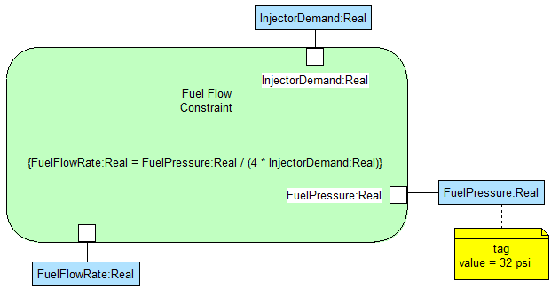
Identify a Performance Constraint for a System Block 23
A Parametric Diagram shows performance constraint equations, defined in constraint blocks mapped to the system’s component parts, with a graphical mapping of each constraint equation parameter to a specific value property of the component part.

Slide 28
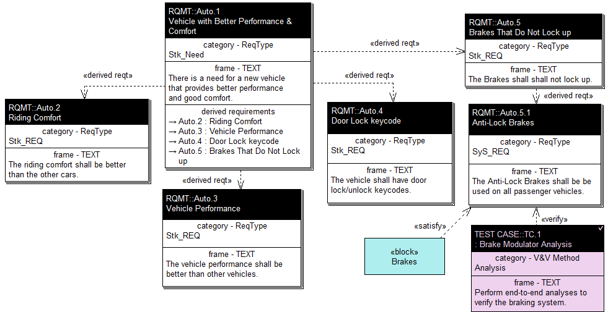
Present Requirements Flow-Down Traceability 24
Requirement Diagrams are used to graphically depict hierarchies of stakeholder needs, requirements and test cases, and show end-to-end traceability to any model element.

Slide 29
Present Requirements Flow-Down Traceability: 2
Requirements Traceability Tables are commonly used on most projects.

